Slide 1
Sugon Infrastructure: PUE < 1.6
Moscow, 12/2015

Slide 2
Agenda
1
Data Center Overview
2
CloudBASE Solutions
3
Liquid-Cooling Server Technology
4
Successful Stories
Notes:
先讲整个IT行业的大背景

Slide 3
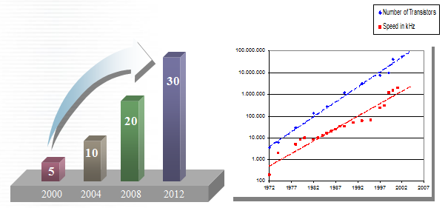
Challenges with High-Density Power Consumption
Moore's law, the density is higher and higher, heat dissipation, the total power consumption
Power Consumption of single Cabinet
(Unit: KW)

Slide 4
Heat Island Phenomenon
The unbalance of the cooling system caused the decrease of MTBF in the system.
Scenario: 1,100 – 1,500 W/m² = 3 - 5 kW / cabinet

Slide 5
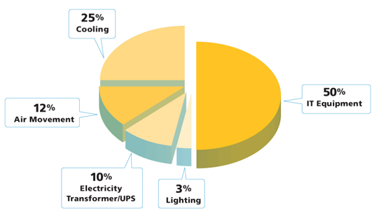
Data Center Energy Consumption
Data Center Power Consumption
Source: EYP Mission Critical Facilities Inc. New York
Analysis of energy consumption by Mission Critical Facilities EYP, USA

Slide 6
PUE: Indicator of data center
PUE: Power Usage Effectiveness
PUE Value of Typical Data Center
Cooling Model | Room Level | Pool Level | Row Level
Sugon Product | C200 | C2000/C4000 | C1000/C3000
Typical PUE | 2.0~2.4 | 1.5~1.8 | 1.4~1.6

Slide 7
Benefit for Lower PUE
Before
PUE |  | 1.6 |  |  | Input Power |  | 1,600 |  | kW
IT Load |  | 1,000 |  | kW | Annual Power Usage |  | 14,016,000 |  | kWh
Price of Power |  | 0.64 |  | RMB/kWh | Annual Cost On Power |  | 8,970,240 |  | RMB
SAVE!
25%
RMB 2.24M
PUE |  | 1.2 |  |  |  | Input Power |  | 1,200 |  | kW
IT Load |  | 1,000 |  | kW |  | Annual Power Usage |  | 10,512,000 |  | kWh
Price of Power |  | 0.64 |  | RMB/kWh |  | Annual Cost On Power |  | 6,727,680 |  | RMB
After

Slide 8
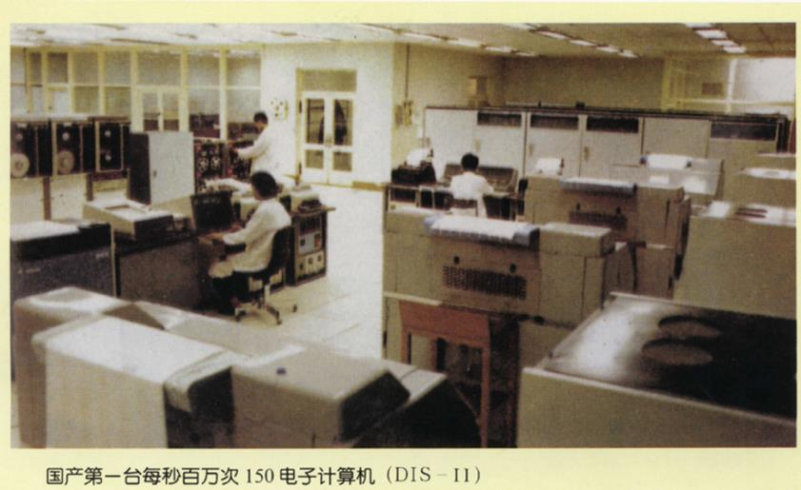
1st Generation Data Center
1960s, Science/Technical Computing, Big Machines

Slide 9
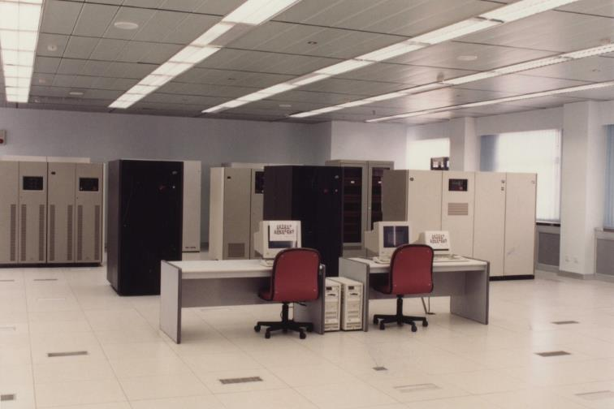
2nd Generation Data Center
1990s, Business Computing, Tower Servers

Slide 10
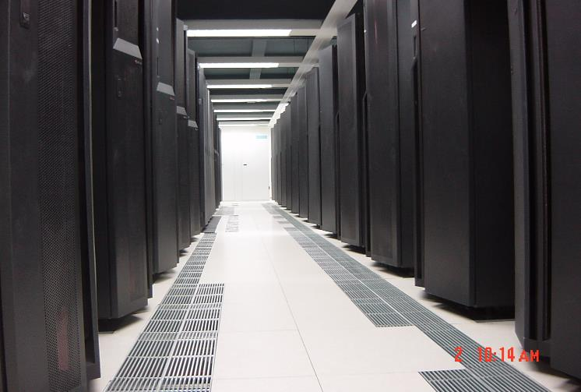
3rd Generation Data Center
2000s, Internet/Communication Industry, Rack Servers

Slide 11
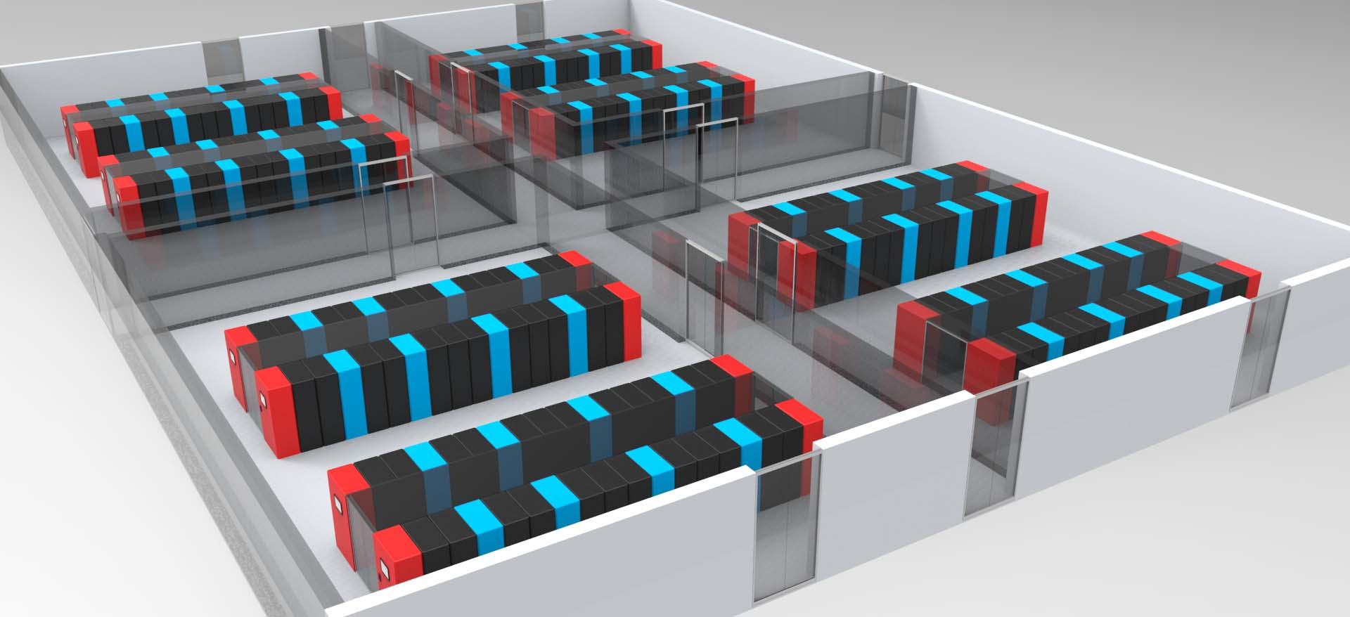
4th Generation Data Center
2010s, Cloud Computing, Micro Modular Integrated Computer Room

Slide 12
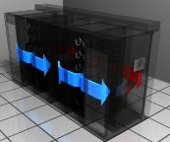
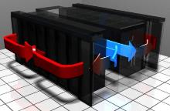
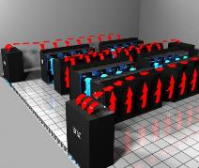
Development of Data Center
Hot and cold channel isolation, airflow organized
Exact nearby air, circulating air resistance, low fan power
The level of air, solve the cabinet vertical temperature gradient
Increase supplied air temperature and reduce power consumption
For refrigeration equipment, without excessive cooling room
机柜级
Rack Level
机柜排级
Row Level
机柜池级
Pool Level
机房级
Room Lever

Slide 13
Agenda
1
Data Center Overview
2
Sugon CloudBASE Solutions
3
Liquid-Cooling Server Technology
4
Successful Stories
Notes:
先讲整个IT行业的大背景

Slide 14
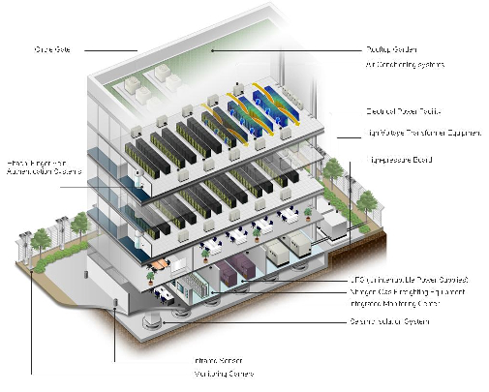
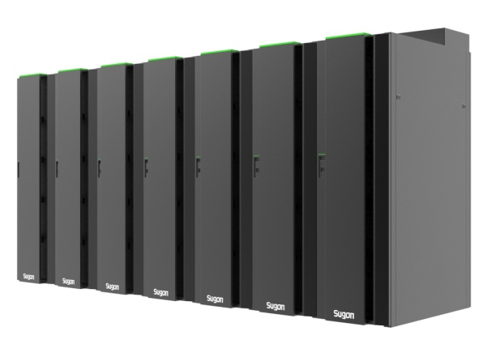
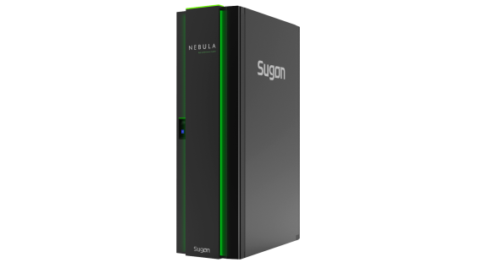
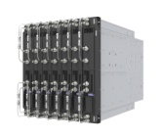
Green IT Infrastructure
Step PUE from 2.2 to 1.2
Server-Level
Liquid-cooling Server
Liquid-cooling Workstation
Cabinet-Level
Cabinet,
Power supplement,
Cooling, Monitoring
Micro Module Level
GreenRow Module
GreenPool Module
Room Level
Plan & Design
Evaluation & Reform

Slide 15
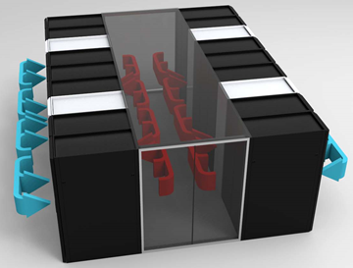
CloudBASE Serials
Mode | In-row | Hot Pool | Cold Pool
Air Flow
Fluorine Cooling Refrigerant 410a | C1000 | C2000 | C2000-H
Water Cooling | C3000 | C4000 | C4000-H
cooling capacity Per Cabinet | 8~30KW | 3~8KW | 10~30KW
Scenarios | High density Computing, such as HPC(High performance computing), large data center | Low density Computing, especially for the pre-installed Cabinet system | Designed for large scale High Performance Computing

Slide 16
Selection of CloudBASE Solutions
Scale of Data Center
Power Density
Maintain Cost
Initial Cost
Room Level
PUE2.0~2.4
Initial Cost + Maintain Cost
Pool Level
PUE 1.5~1.8
Row Level
PUE 1.4~1.6
Operating Time

Slide 17
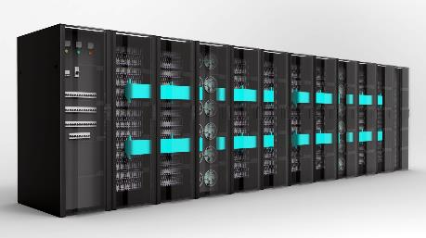
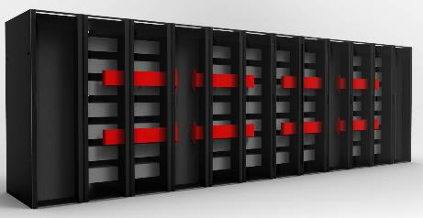
Row-level Solutions (C1000/C3000)
External compressor, reducing machine vibration impact on IT equipment
Compressor N + 1 redundancy, where 1 is the inverter compressor station can dynamically adjust the amount of refrigerant
Refrigerant pipe length 80 meters maximum range, far higher than traditional precision air conditioning, reduce space constraints

Slide 18
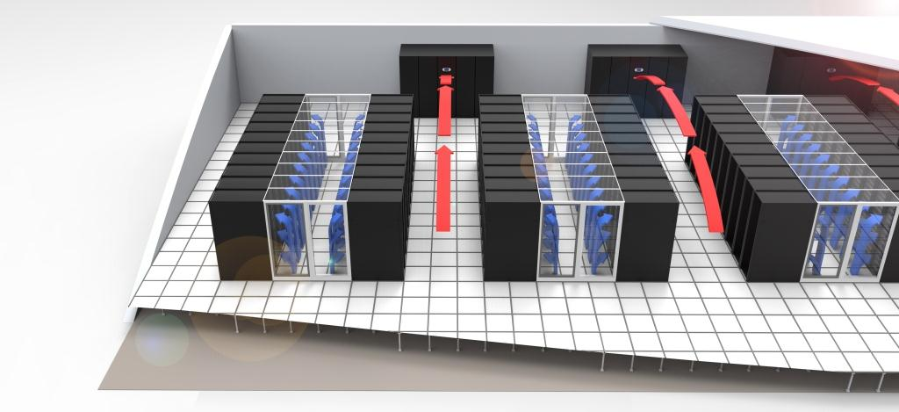
Large Scale Solutions
Large Scale Solution
Larger Scale system can be combined TC5600 with CloudBASE C2000 pool level cooling system to achieve mass deployment Supercomputer Center PUE≤1.5, effectively droping TCO costs

Slide 19
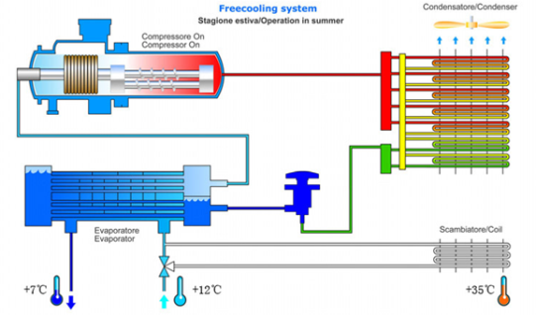
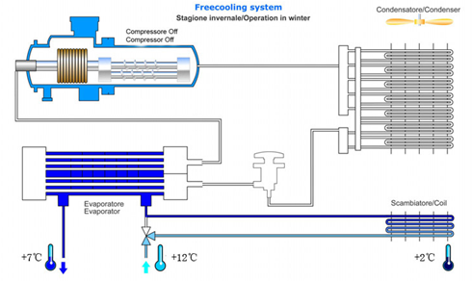
Water-cooling Chiller with Natural cooling Solution
T≤5℃ Full Natural Wind Cooling
5℃＜T≤13℃ Part of Natural Wind Cooling
T＞13℃ Air Conditioner Cooling
Water-cooling chillers with natural wind cooling energy-saving module
In winter, chiller refrigeration compressor open alternative drycooler to provide chilled water for the air-conditioning machine

Slide 20
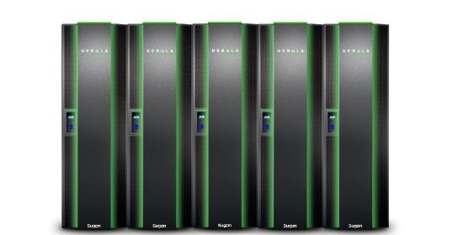
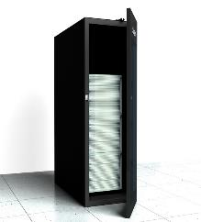
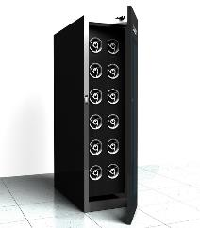
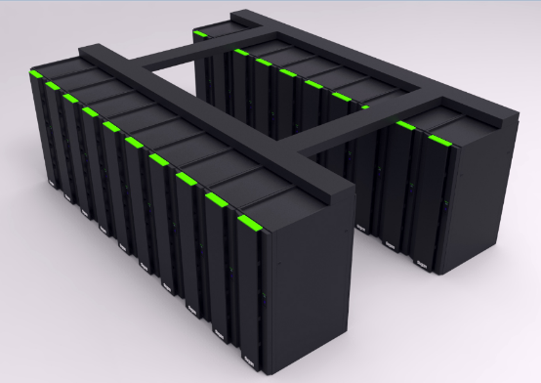
Sugon Cabinets
C200 / C1000 / C2000 / C3000
Cabinet uniform appearance
Aluminum-magnesium alloy cabinet profiles
Light weight, high strength, static bearing 1000kg Top-mounted integrated strength of the wire groove
Electric access door and smoke automatic door

Slide 21
Advantage of Sugon CloudBASE Solutions
High Density
Channel closed, the level of air, hot and cold air isolation order, improve the cooling efficiency
Green IT
The level of air, the nearest refrigeration, air-conditioning return air temperatures increase, lower energy efficiency
Smart
High Avaliability
Modular design, flexible deployment, adaptation stage partition construction
Standard
Engineering products of the factory completion of the inspection, site integration Integration . Implemetation period is shortened by 20% to 30%
Advanced
4th generation data center concept
Intelligent engine room centralized management, IT and "IT microenvironment" unified infrastructure management platform
Two kinds of chilled water and freon refrigeration systems, support winter natural cooling technology
Total solutions
Optimization of energy consumption indicators PUE, saving 15% to 20%, saving space by 30% to 40%

Slide 22
Agenda
1
Data Center Overview
2
Sugon CloudBASE Solutions
3
Liquid-Cooling Server Technology
4
Successful Stories
Notes:
先讲整个IT行业的大背景

Slide 23
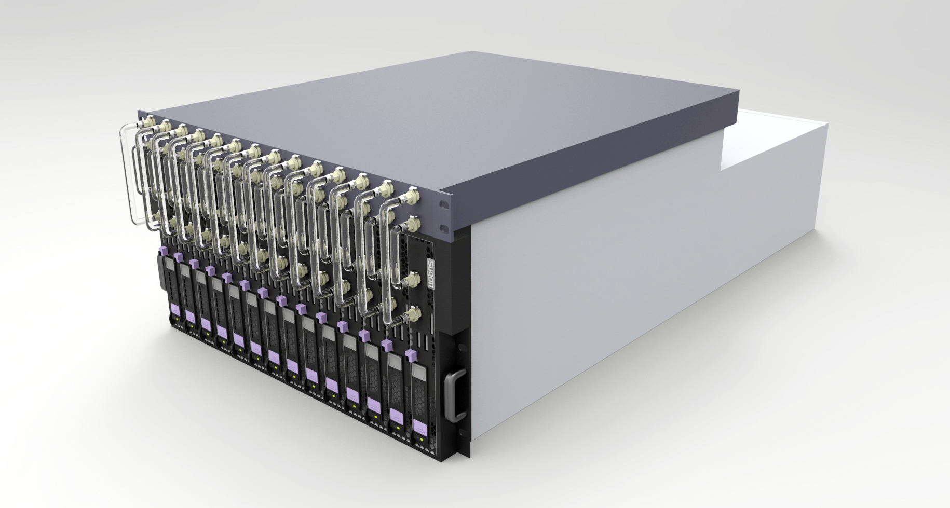
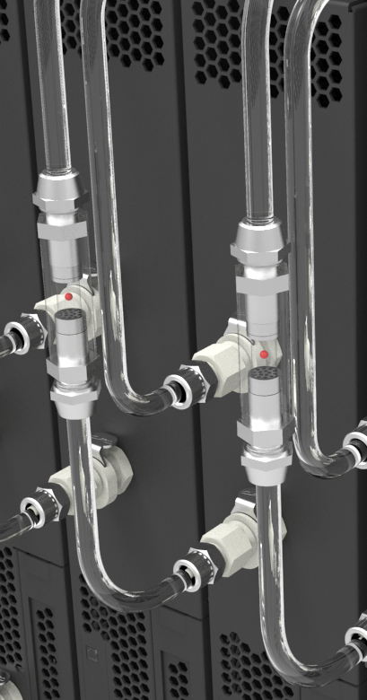
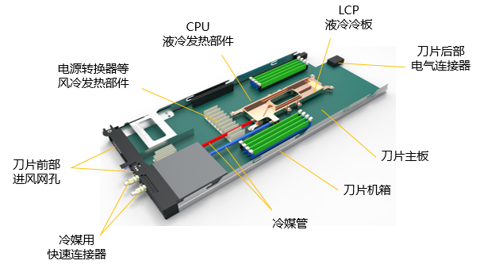
Liquid Cooling Servers
TC4600-LP
5U 10Blade
Intel Xeon E5-2600 V2/V3
PCIe 3.0 FDR 56Gb/s InfiniBand
Advanced
More power saving: Fans 70%, Air Conditioner 80%
More Reliability: Reduce the temperature of processor by 20℃
Low Noise: Reduce the noise by 10dB
Higher Performance: Up to 5% with overclocking

Slide 24
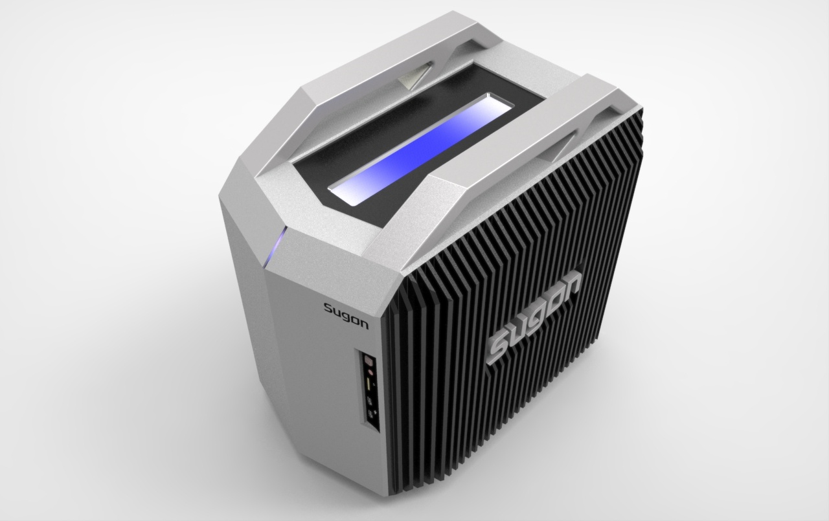
Immersion cooling workstation W560-LI
Feature
Silicone Media
Immersion cooling technology
Fanless design
Advantage
Ultra Low Noise: 35dB
High reliability dust-proof
Moistureproof
Anti-salt spray
Anti-sulfide

Slide 25
Agenda
1
Data Center Overview
2
Sugon CloudBASE Solutions
3
Liquid-Cooling Server Technology
4
Successful Stories
Notes:
先讲整个IT行业的大背景

Slide 26
Some Successful Stories in Infrastructure Field

Slide 27
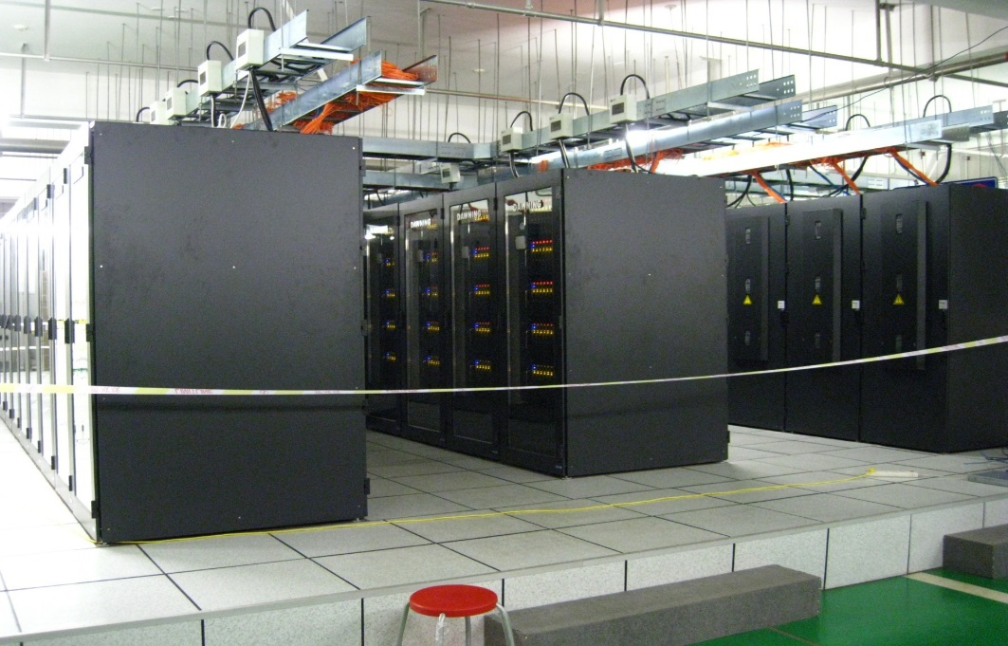
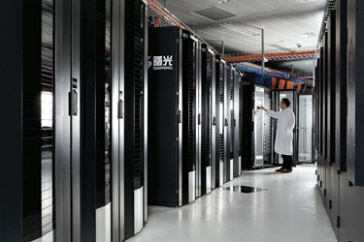
Magic Cube (TC5000A, 2008)
Rank No.10th
3840 2-way TC2600
First Chinese-designed Blade
InfiniBand interconnection
Peak Perf.: 233.5 Tflops
The Largest Window HPC in the World
Notes:
In 2008, we ranked No.10th of the world’s top500 supercomputer again, this computer system named Magic cube.
Magic Cube at the Shanghai Supercomputer Center was the most powerful system outside the U.S.
It was the largest system which can be operated with Windows HPC 2008 operating system.

Slide 28
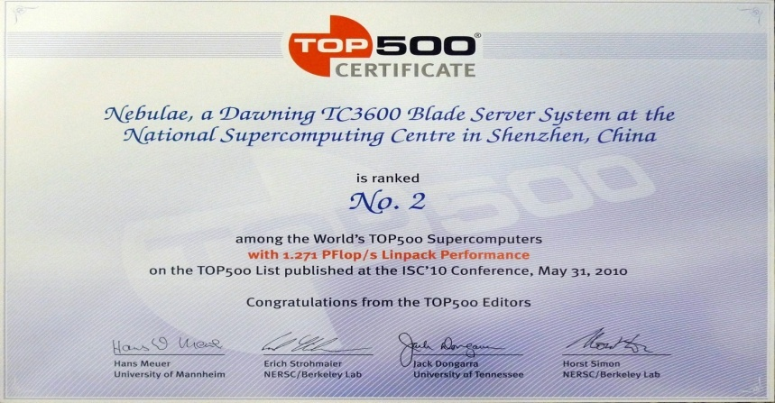
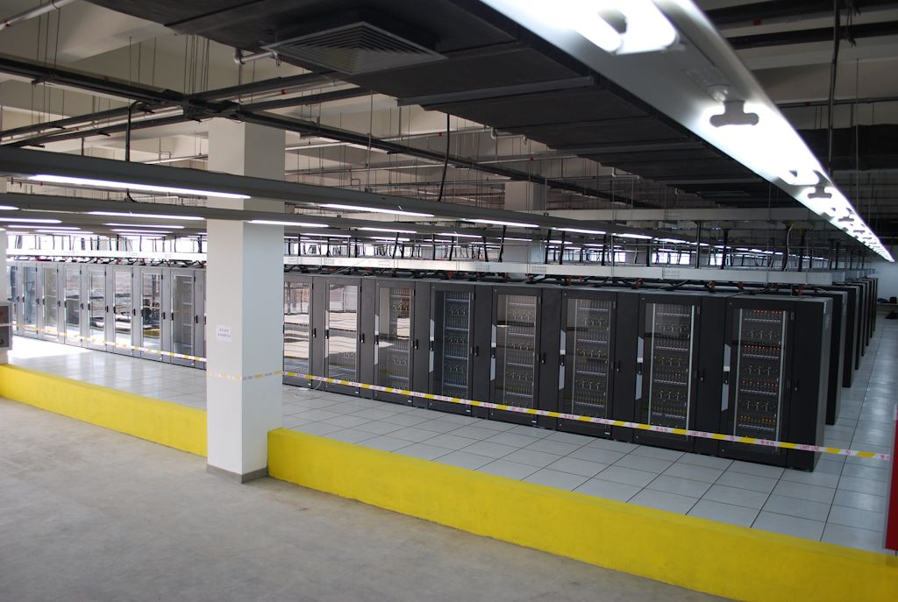
Dawning 6000 (2010)
No.1st theoretical peak performance, No.2nd in Linpack performance , 5500 2-way TC3600, NVidia C2050, InfiniBand, 2.98 Pflops
First Intel SSI architecture Blade Server
the largest CPU+GPU supercomputer in the world
Notes:
In 2010, Sugon have made a huge progress,We hit the NO.2 of the world’s top500 supercomputer.
This computer system named Nebulae, build from a Dawning TC3600 Blade system with Intel X5650 processors and NVidia Tesla C2050 GPUs It was the fastest in theoretical peak performance at 2.98 Peta Flop/s and No. 2 with a Linpack performance of 1.271 PFlop/s. This is the highest rank a Chinese system ever achieved.

Slide 29
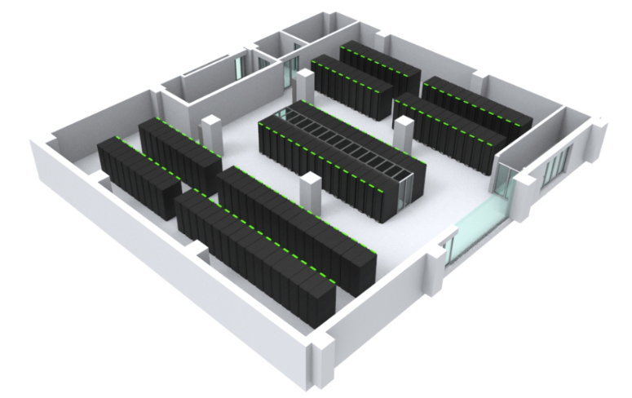
LandOcean Beijing Processing Center
600 square meters of room area, installed capacity of 1 MW
C3000 row-level solution for CPU&GPU Computing Region
C4000 hot-pool solution for Storage Region
Natural Cooling Technology, PUE<1.4
T≤5℃ Full Natural Wind Cooling
5℃＜T≤13℃ Part of Natural Wind Cooling
T＞13℃ Air Conditioner Cooling
42* 30KW Liquid-cooling in-row air conditioners
40* High-density Isolated Cabinet
26* Normal Cabinets
2* 550KW Natural cooling water chiller unit
1* Suit of Power Supplement & IMMS

Slide 30
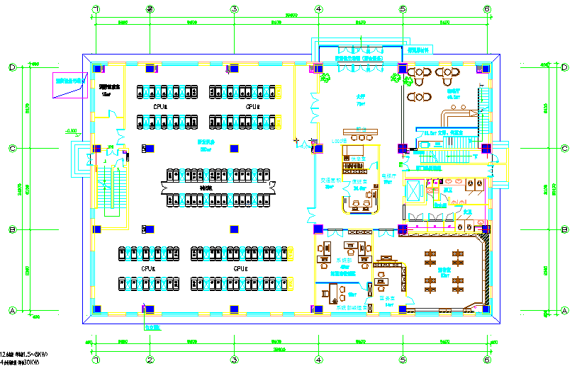
LandOcean Beijing Processing Center

Slide 31
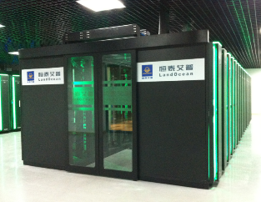
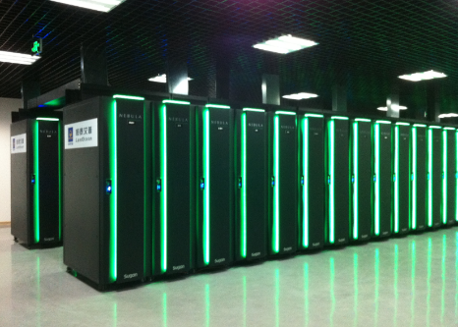
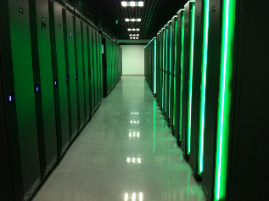
LandOcean Beijing Processing Center

Slide 32
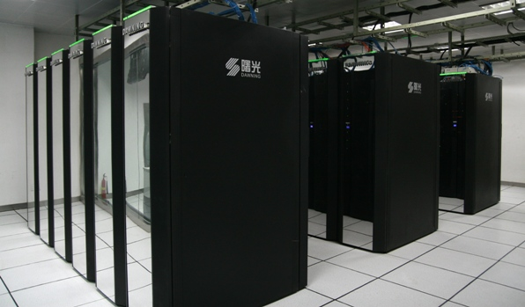
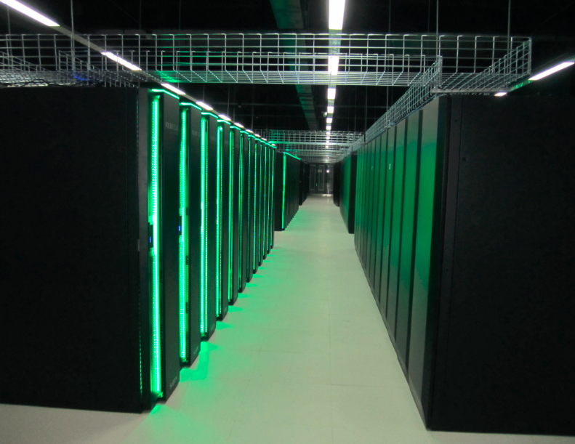
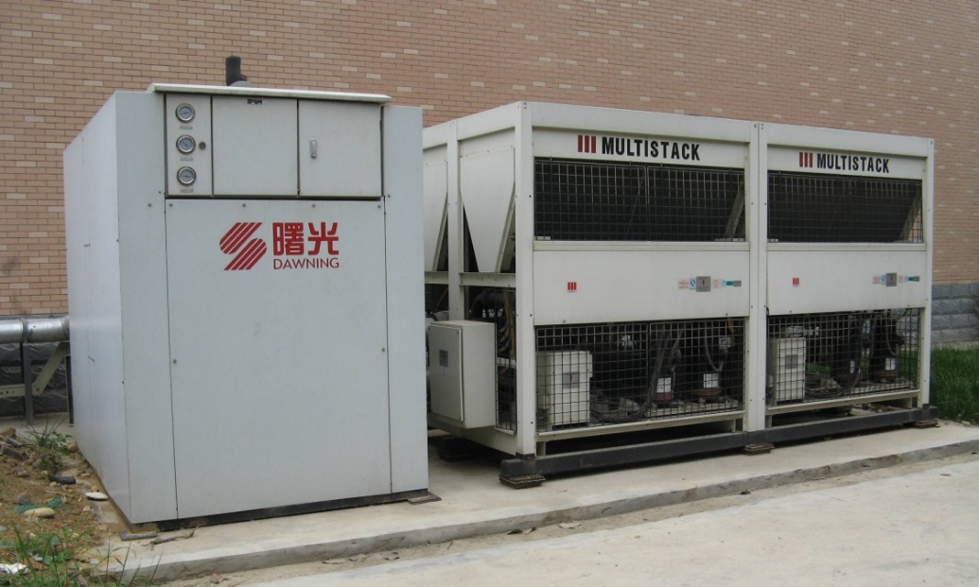
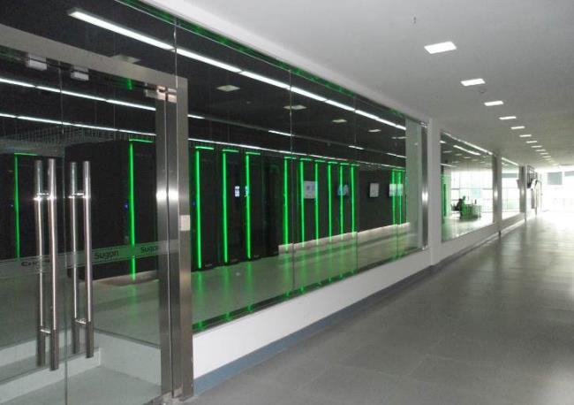
Chengdu & Nanjing Cloud Computing Center
1st period, 2009, 300 servers
1st period, 2012, 1000 servers

Slide 33
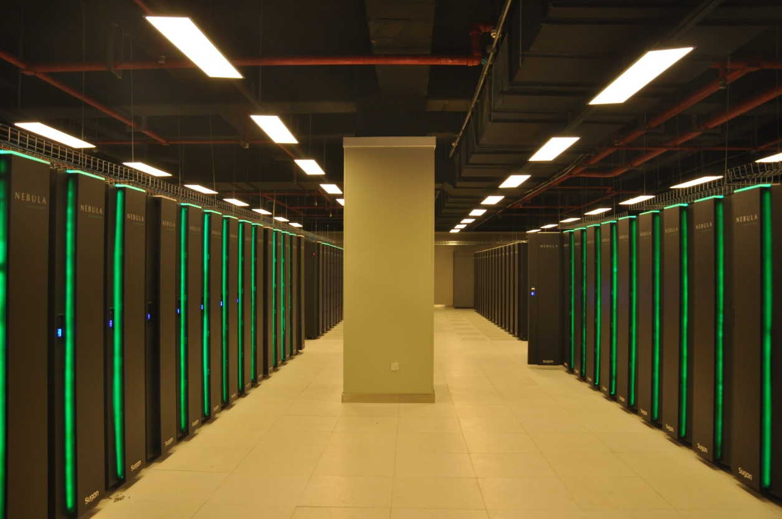
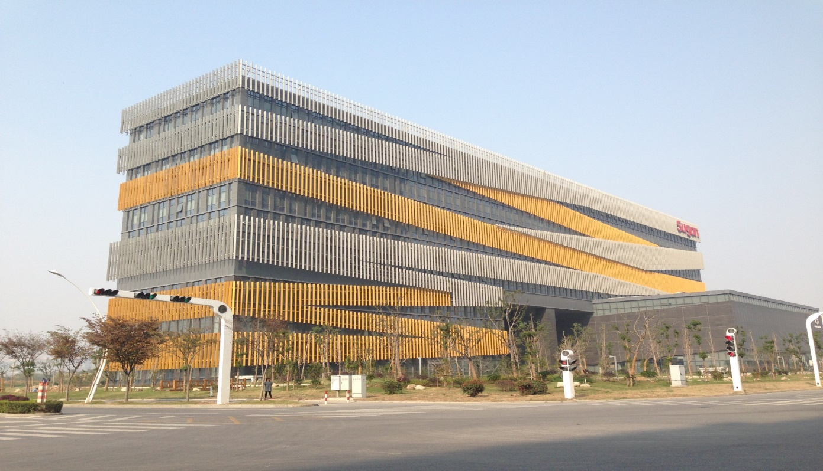
Wuxi City Cloud Center
Constructed in 2011, 5000 servers, public cloud service

